Slide 1
Lunch & Learn 2021-0X-XY

Slide 2

Azure Durable Functions
Vad ska man ha dom till?!

Slide 3
Azure Functions - bas
Från docs.microsoft.com:
Serverless
Write less code
Maintain less infrastructure
Save costs
Focus on (pieces of) code that matter the most to you, and Azure functions handles the rest
https://docs.microsoft.com/en-us/azure/azure-functions/functions-overview

Slide 4
Serverless?
Fritt översatt från en.wikipedia.org:
En exekveringsmodell som hanteras helt av en molnleverantör vad gäller
servrar
kapacitet
konfiguration
underhåll
uppdateringar
https://en.wikipedia.org/wiki/Serverless_computing

Slide 5
Azure Functions - bas (forts)
Fokus på kod, som ska köras
Microsoft tar hand om resten, nästan...
Viss configuration
Val av Service Plan påverkar
tillgänglighet,
pris,
timeout, från trigger till resultat
etc...
https://docs.microsoft.com/en-us/azure/azure-functions/functions-scale

Slide 6
Azure Functions - bas (forts)
Triggers, ett urval:
Http & webhooks
Timer
Service bus
Queue, table & blob storage
etc...
Input och output bindnings:
Queue, table & blob storage
Cosmos DB
etc...
https://docs.microsoft.com/en-us/azure/azure-functions/functions-triggers-bindings?supported-bindings
https://docs.microsoft.com/en-us/azure/azure-functions/functions-bindings-example

Slide 7
Azure Durable Functions
Som Azure Functions men med:
Möjlighet att spara tillstånd - stateful
Bygga orkestreringar - orchestrations
Beständinga entiteter - durable entities
https://docs.microsoft.com/en-us/azure/azure-functions/durable/durable-functions-overview

Slide 8
Azure Durable Functions (forts)
Det finns ett antal mönster:
Function chaining
Fan-out/fan-in
Async http (api:s)
Monitoring
Human interactions
Aggregator (stateful entities)
https://docs.microsoft.com/en-us/azure/azure-functions/durable/durable-functions-overview#application-patterns

Slide 9
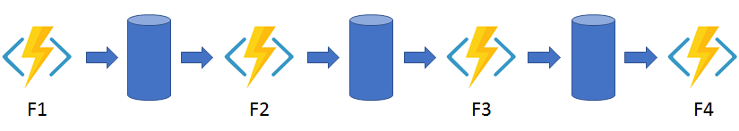
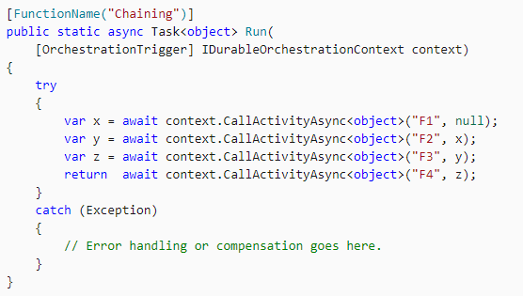
Function chaining
https://docs.microsoft.com/en-us/azure/azure-functions/durable/durable-functions-overview#chaining
Mönster

Slide 10
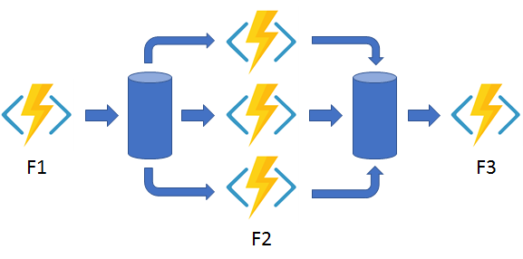
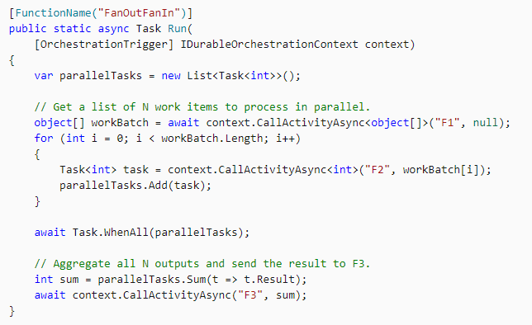
Fan-out/fan-in
https://docs.microsoft.com/en-us/azure/azure-functions/durable/durable-functions-overview#fan-in-out
Mönster

Slide 11
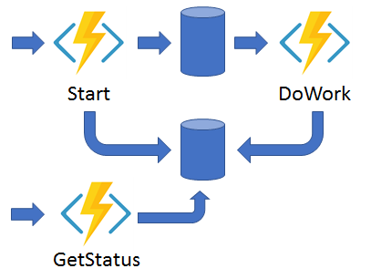
Async Http (api:s)
https://docs.microsoft.com/en-us/azure/azure-functions/durable/durable-functions-overview#async-http
Mönster

Slide 12
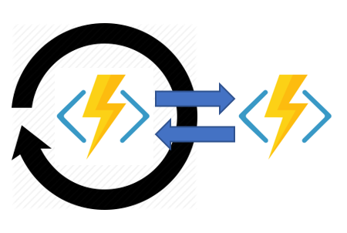
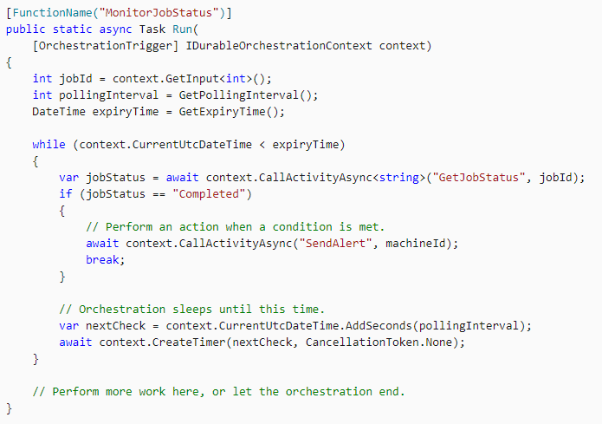
Monitor
https://docs.microsoft.com/en-us/azure/azure-functions/durable/durable-functions-overview#monitoring
Mönster

Slide 13
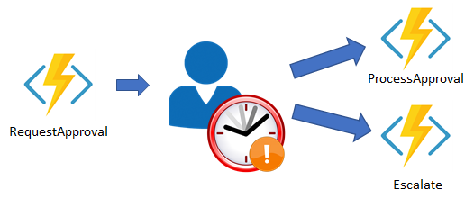
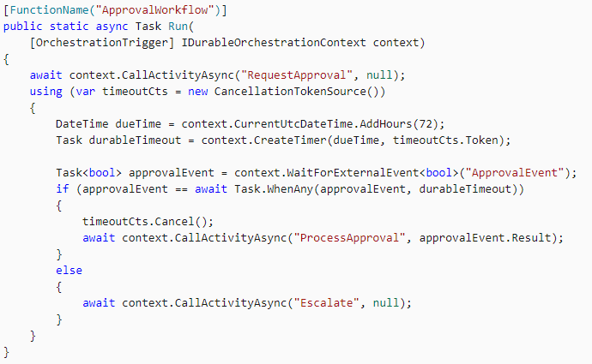
Human interaction
https://docs.microsoft.com/en-us/azure/azure-functions/durable/durable-functions-overview#monitoring
Mönster

Slide 14
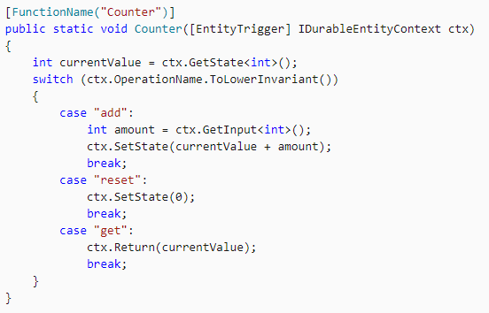
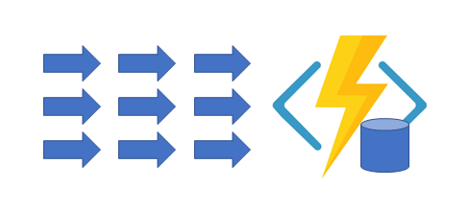
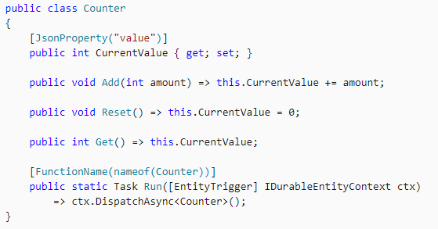
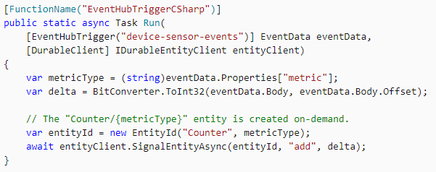
Aggregator (stateful entities)
https://docs.microsoft.com/en-us/azure/azure-functions/durable/durable-functions-overview#monitoring
Function-based syntax
Mönster
Class-based syntax

Slide 15
Vad ska vi bygga idag?
Ett godkännandeflöde, dokument för signering
Generera x antal dokument
För varje godkännare:
Notifiera att dokument finns att signera
Vänta på feedback
Klart!
main orchestration
x no of activities (kan vara fire-n-forget)
gen doc
x no of sub-orchs (kan vara fire-n-forget)
notify
wait for feedback

Slide 16

Work is not a place
This is a very important part of the Modern Workplace
Xxxxxx
Xxxx
Xxxx
Xxx

Slide 17

Modern Workplace by Infozone
We build the Modern Workplace based on…………….

Slide 18
Clean and simple slide
Xxxx
Xxxx
Xxxx

Slide 19
Infozone and Microsoft – Let’s see the difference
Test
Test
Make comparisons in your presentation
Make comparisons

Slide 20
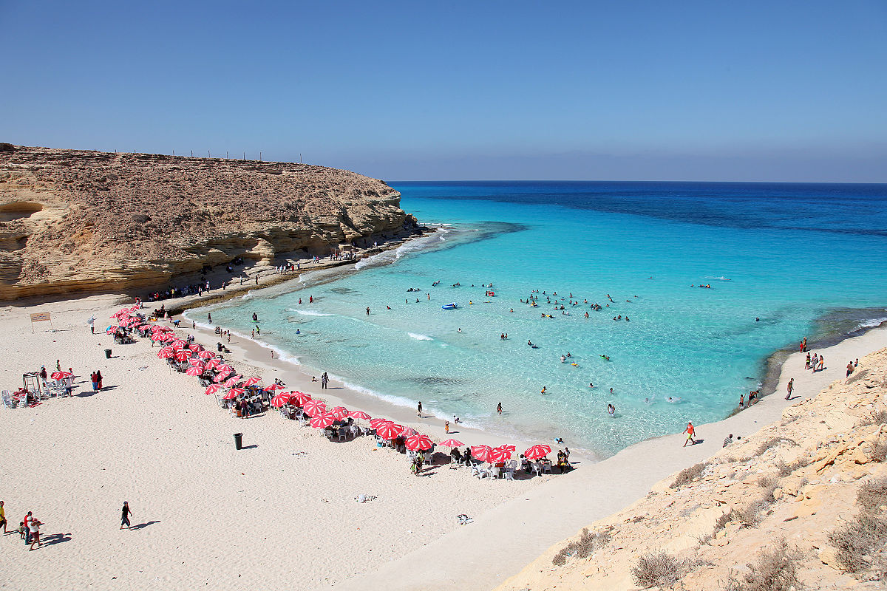
Looks nice with the ocean – right?
Det här fotot av Okänd författare licensieras enligt CC BY-SA
Det här fotot av Okänd författare licensieras enligt CC BY-SA

Slide 21
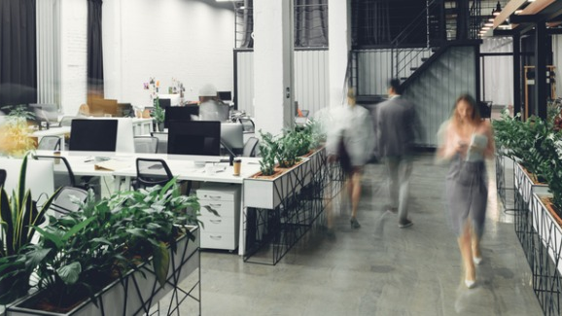
This is just example slides do not use the text

Slide 22


Slide 23

Modern Workplace

Slide 24

Title
xxxxxx
Write what you wish to present
Xxxxx
Xxxxx
Xxxx
Xxxx
Xxxx

Slide 25

You can present and make your own changes into what you prefer in your presentation.

Slide 26

Work is not a place…..

